Slide 1
IBM University Engagement Project Submission
“Exploring the Power of Agentic AI with IBM Granite ”

Slide 2

Project Title: AI Agent for Chronic diseases Monitering
Domain of Project: HEALTHCARE
Student Name | Passport Size Photo | Email ID | Mobile Number (WhatsApp)
Sanskruti Santosh Pallod |  | pallodsanskruti@gmail.com | 7276179531

Slide 3
Problem Statement :- AI agent for chronic disease monitoring
The Challenge - An AI agent for chronic disease monitoring helps patients and healthcare providers
manage long-term conditions effectively.
It continuously analyzes health data from wearables, medical records, and patient inputs to detect early
warning signs.
Using AI and predictive analytics, it offers personalized insights, medication reminders, and lifestyle
recommendations.
The agent supports diseases like diabetes, hypertension, and heart conditions with real-time monitoring
and alerts.
It enables proactive care, reduces hospital visits, and improves patient adherence to treatment plans.
This intelligent assistant bridges the gap between patients and providers, enhancing chronic care
outcomes.

Slide 4
PROJECT STRUCTURE:-
CareGuard AI
├── app.py ← Flask entry point & all routes
├── config.py ← Environment config (reads .env)
├── agent_instructions.py ← CUSTOMIZE AI behaviour here
├── models.py ← Data models, health simulators, risk scorer
├── watsonx_client.py ← IBM Watsonx.ai / Granite integration
├── requirements.txt
├── .env.example ← Copy to .env and fill in credentials
├── templates/
│ ├── base.html ← Shared layout (navbar, footer, theme)
│ ├── dashboard.html ← Main health dashboard
│ ├── chat.html ← AI chat interface
│ ├── patient_profile.html← Patient information form
│ ├── medications.html ← Medication tracker
│ ├── caregivers.html ← Family / care team
│ └── error.html
└── static/
├── css/style.css ← All styles (light + dark theme)
└── js/app.js ← Theme toggle, toasts, markdown renderer

Slide 5
Proposed Solution:
The core thesis of CareGuard AI is that continuous, AI-augmented monitoring between clinical visits can reduce preventable acute events in chronic disease patients, improve long-term medication adherence, and empower patients with actionable, personalised health guidance — without requiring hospital infrastructure or continuous physician involvement.
Overveiw:
CareGuard AI, a web-based intelligent health monitoring agent purpose-built for patients living with chronic conditions such as Type 2 Diabetes, Hypertension, Heart Disease, and related co-morbidities. The fundamental motivation behind this solution is to close the feedback gap that exists between clinical visits — a gap during which patients receive no professional guidance, often resulting in delayed recognition of deteriorating health, poor medication adherence, and preventable emergency admissions.
CareGuard AI addresses this problem by providing continuous, AI-augmented health monitoring directly through a web browser. It combines a Python Flask web application, a clinically parameterised health data simulator, a rule-based risk scoring engine, and a conversational AI assistant powered by IBM Watsonx.ai using the IBM Granite family of large language models. The system is designed to work entirely offline when IBM cloud credentials are unavailable, ensuring resilience in low-connectivity or demonstration environments through a built-in local AI engine that mirrors the behaviour of the Granite model.

Slide 6
Design Goals and Guiding Principles
The design of CareGuard AI was guided by five core principles that shaped every architectural and implementation decision throughout the project.
The first principle is offline-first resilience. The application is engineered to function fully without cloud credentials. A local rule-based AI engine within watsonx_client.py serves as a drop-in replacement for the IBM Granite API, returning structured, clinically grounded responses to patient queries with no external network calls. This ensures that the system remains usable for demonstrations, rural deployments, or environments with unreliable internet connectivity.
The second principle is patient-centric personalisation. Every interaction with the AI layer is enriched with the patient's current profile before the request is dispatched. This includes demographics, existing diagnoses, current medications, known allergies, family history of hereditary diseases, and the patient's most recent vital-sign reading. By injecting this context at the system-prompt level, the agent is transformed from a generic language model into a patient-specific health advisor at inference time, without any model fine-tuning.

Slide 7
The third principle is safety by design. Seven mandatory safety rules are hard-coded into the agent's system prompt and are never overridden by user input or model inference. These rules prohibit the agent from diagnosing new conditions, prescribing or modifying drug dosages, or dismissing patient-reported symptoms. In all cases where vital signs exceed critical thresholds, the agent's first response is to direct the patient to call emergency services. A medical disclaimer is appended to every health-status output, reinforcing that the application provides guidance rather than clinical diagnosis.
The fourth principle is extensibility without code changes. Disease specialisations, alert thresholds, the AI model identifier, and generation hyperparameters are all externalised into two configuration files — agent_instructions.py and config.py. Enabling support for a new chronic condition (for example, Rheumatoid Arthritis, currently disabled) requires a single boolean change. Switching from the Granite 4-H Small model to Granite 3.3-8B Instruct requires changing one string. This design lowers the barrier for clinical teams or researchers to adapt the system for different patient populations.
The fifth principle is immediate deployability. The project ships with a Procfile for Gunicorn, a runtime.txt specifying the Python version, and complete deployment scripts for IBM Cloud Code Engine and IBM Cloud Foundry. A developer can go from a clean checkout to a running production deployment in under ten minutes.

Slide 8
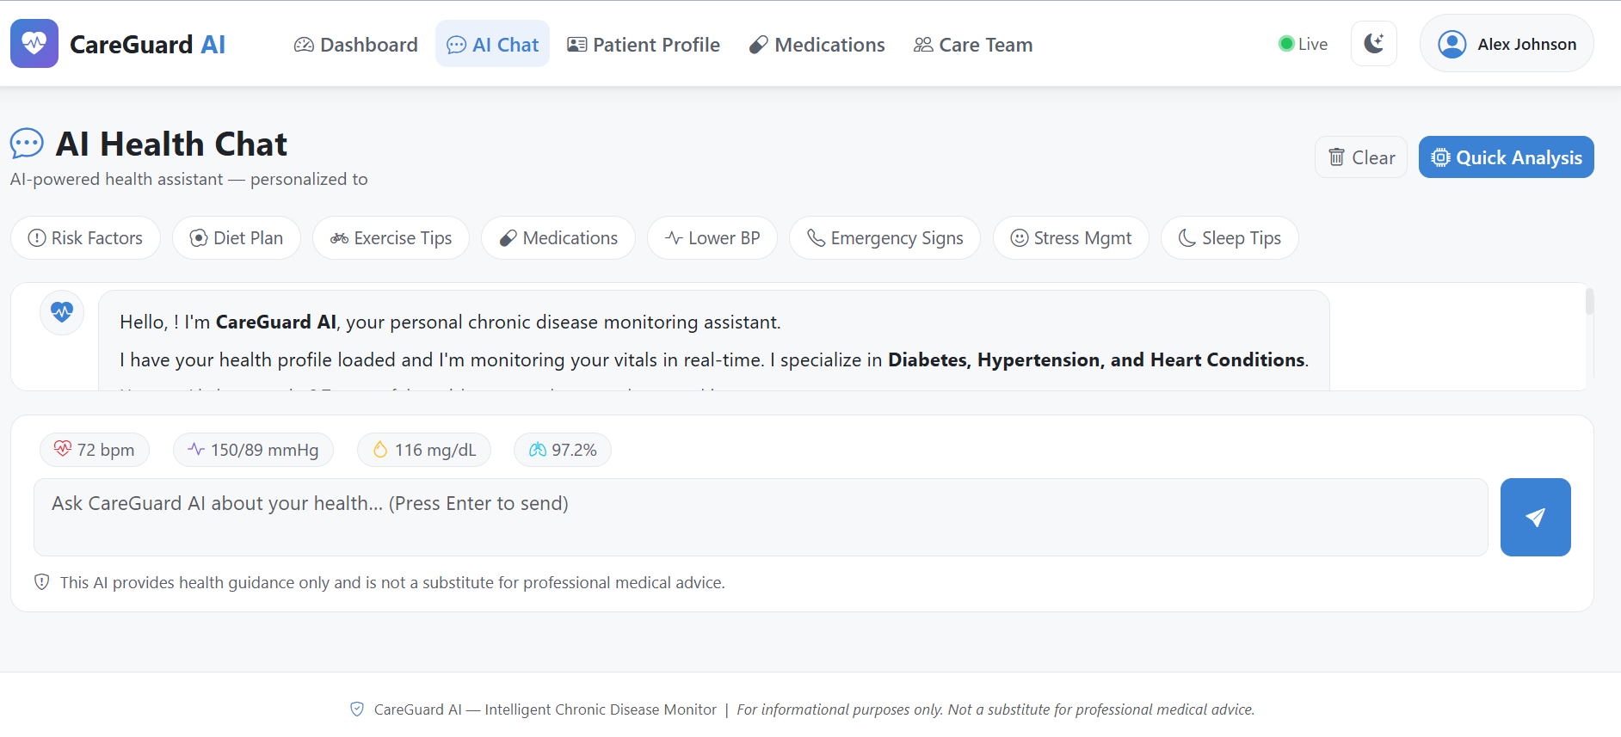
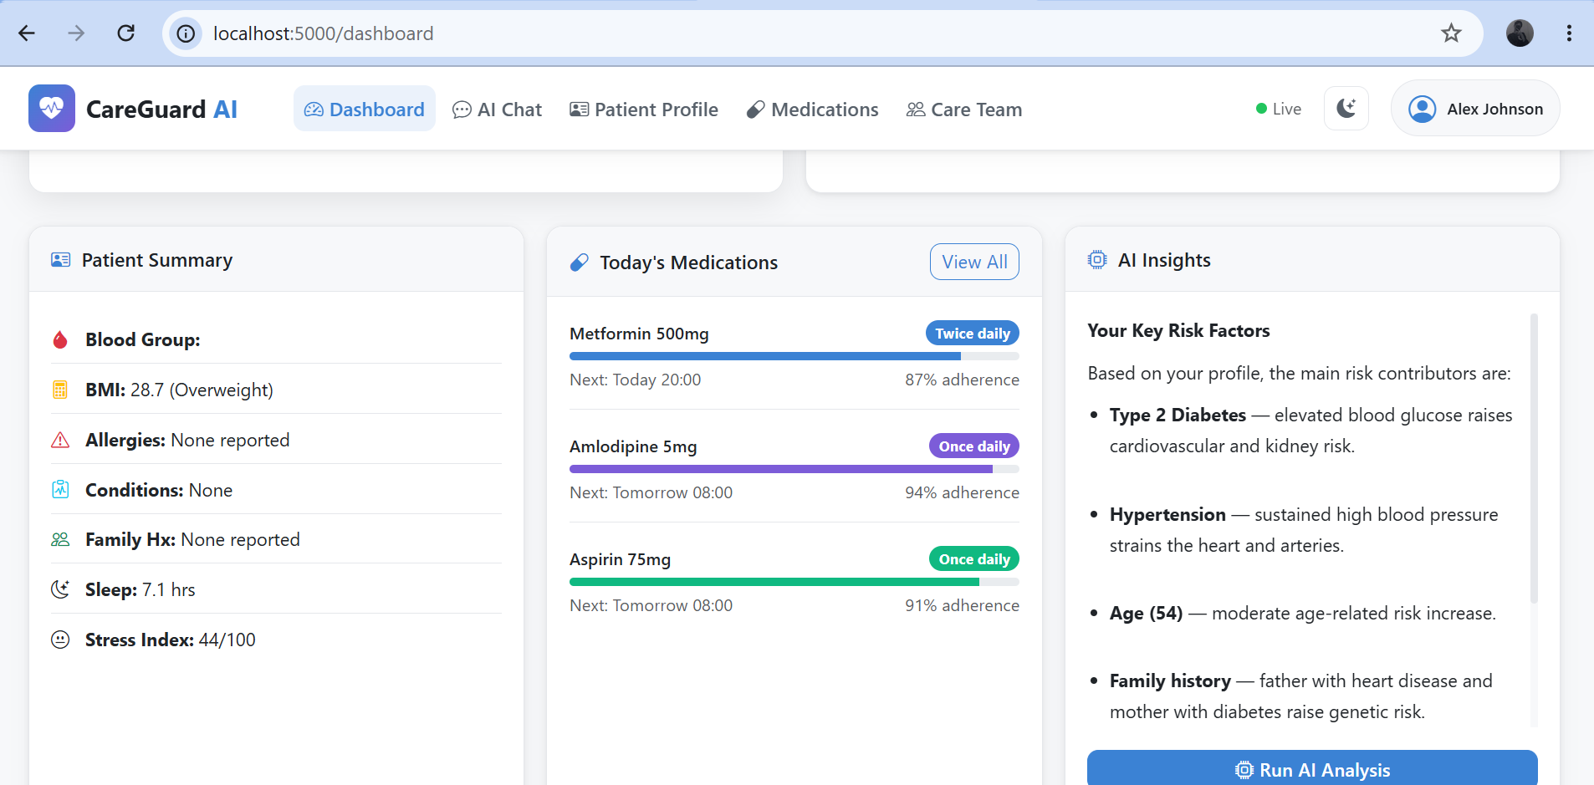
conversational AI chat interface allows the patient to ask natural-language health questions. The agent maintains an in-memory conversation history of up to forty messages and enriches each outgoing message with the patient's latest vitals before querying the AI layer. Quick-prompt buttons on the chat page provide one-click access to common topics such as diet, exercise, medications, and emergency guidance.
The live health dashboard displays the patient's latest simulated vital signs — heart rate, blood pressure, blood glucose, oxygen saturation, body temperature, step count, sleep duration, and stress index — alongside a calculated BMI and risk score, with Chart.js line graphs showing seven-day trends for glucose, systolic blood pressure, and heart rate. The dashboard auto-refreshes via AJAX every thirty seconds to simulate continuous wearable monitoring.

Slide 9
TECHNOLOGY USED
IBM Watsonx.ai
IBM's enterprise AI platform, accessed via the ibm-watsonx-ai Python SDK. Provides hosted large language model inference with enterprise-grade security and compliance. Used as the primary AI reasoning backend when credentials are configured.
IBM Granite (ibm/granite-4-h-small)
The IBM Granite family of instruction-tuned language models, configured in config.py. The default model is ibm/granite-4-h-small, with ibm/granite-3-3-8b-instruct and ibm/granite-3-8b-instruct available as alternatives. Generates personalised health analysis, chat responses, and medication advice from structured clinical system prompts.
IBM Cloud Code Engine
Fully managed, serverless container platform on IBM Cloud. The primary recommended production deployment target. Application source is packaged and deployed via the IBM Cloud CLI (ibmcloud ce app create), with secrets injected as environment variables and a minimum of one always-on instance configured to avoid cold starts.

Slide 10
SAFETY,ETHICS and LIMITATIONS
Safety Model
Built on 7 mandatory rules in SAFETY_RULES (agent_instructions.py)
Agent flags risk indicators & recommends professional evaluation — never diagnoses, alters dosages, or dismisses symptoms
Critical vital signs trigger emergency escalation as top priority
Every health response includes mandatory medical-advice disclaimer
Ethical Design
Patient data stored only in browser session — no persistent server-side database
Reduces unauthorized access risk, but data doesn't survive session expiry
Care team portal uses role-based access to limit info to designated scope
Key Limitations
Uses statistical simulator, not real wearable device data
Simulator can't replicate inter-day variability, sensor artifacts, or patient-specific metabolic patterns
Production deployment needs validated wearable hardware + FHIR-compliant pipelines
In-memory chat history doesn't persist — no access to longitudinal conversation history across sessions

Slide 11
Multilingual and Accessibility Support
Chronic diseases disproportionately affect populations in low- and middle-income countries, many of which are linguistically diverse. A future version of CareGuard AI would introduce multilingual support using IBM Watsonx.ai's multilingual Granite models and Flask-Babel for interface localisation, enabling the application to serve patients in languages such as Hindi, Arabic, Spanish, French, Swahili, and Mandarin without requiring separate codebases. The AI chat agent, medication reminders, and emergency guidance would all be delivered in the patient's preferred language.
Accessibility improvements would ensure compliance with the Web Content Accessibility Guidelines (WCAG 2.1 AA standard), including sufficient colour contrast ratios in both light and dark themes, full keyboard navigability, screen-reader-compatible ARIA labels on all interactive elements, and voice input support for patients with limited fine motor control — a common co-morbidity in advanced diabetes and arthritis patients.

Slide 12
GitHub Link: https://github.com/pallodsanskruti-oss/ChroniDiseaseAgent

Slide 13
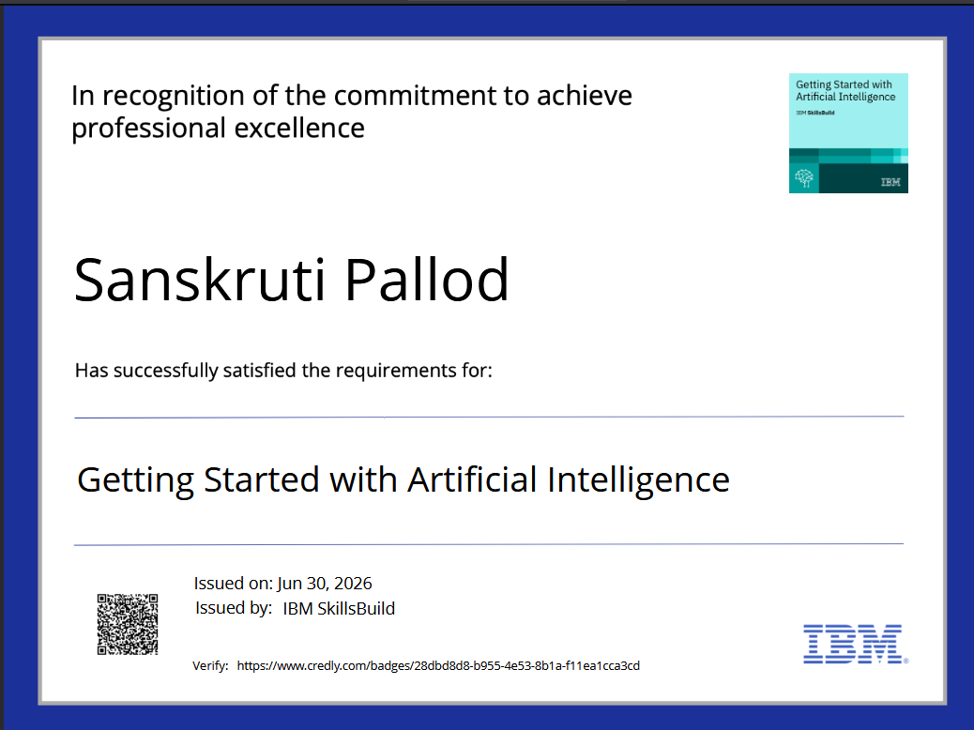
Credly certificate for Getting Started with AI

Slide 14
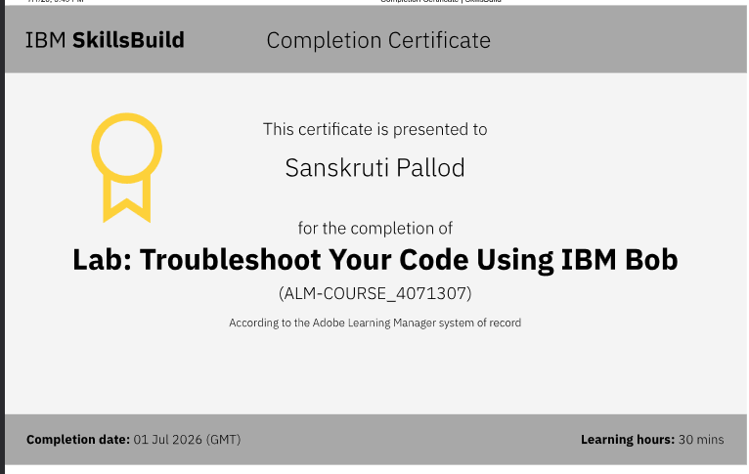
IBM BOB Troubleshoot certificate

Slide 15
THANK YOU

